Slide 1
2023 TT Physiology Paper Display Items and General Discussion
January 16, 2023

Slide 2
Statistical Approach
Linear mixed effect models
Alliaria treatment included as categorical fixed effect in all models
Soil characteristics
Variable ~ Alliaria treatment * tree canopy status + (1 | plot)
Physiology traits
Variable ~ Alliaria treatment * tree canopy status + soil N availability +
phosphate availability + (1 | plot)

Slide 3
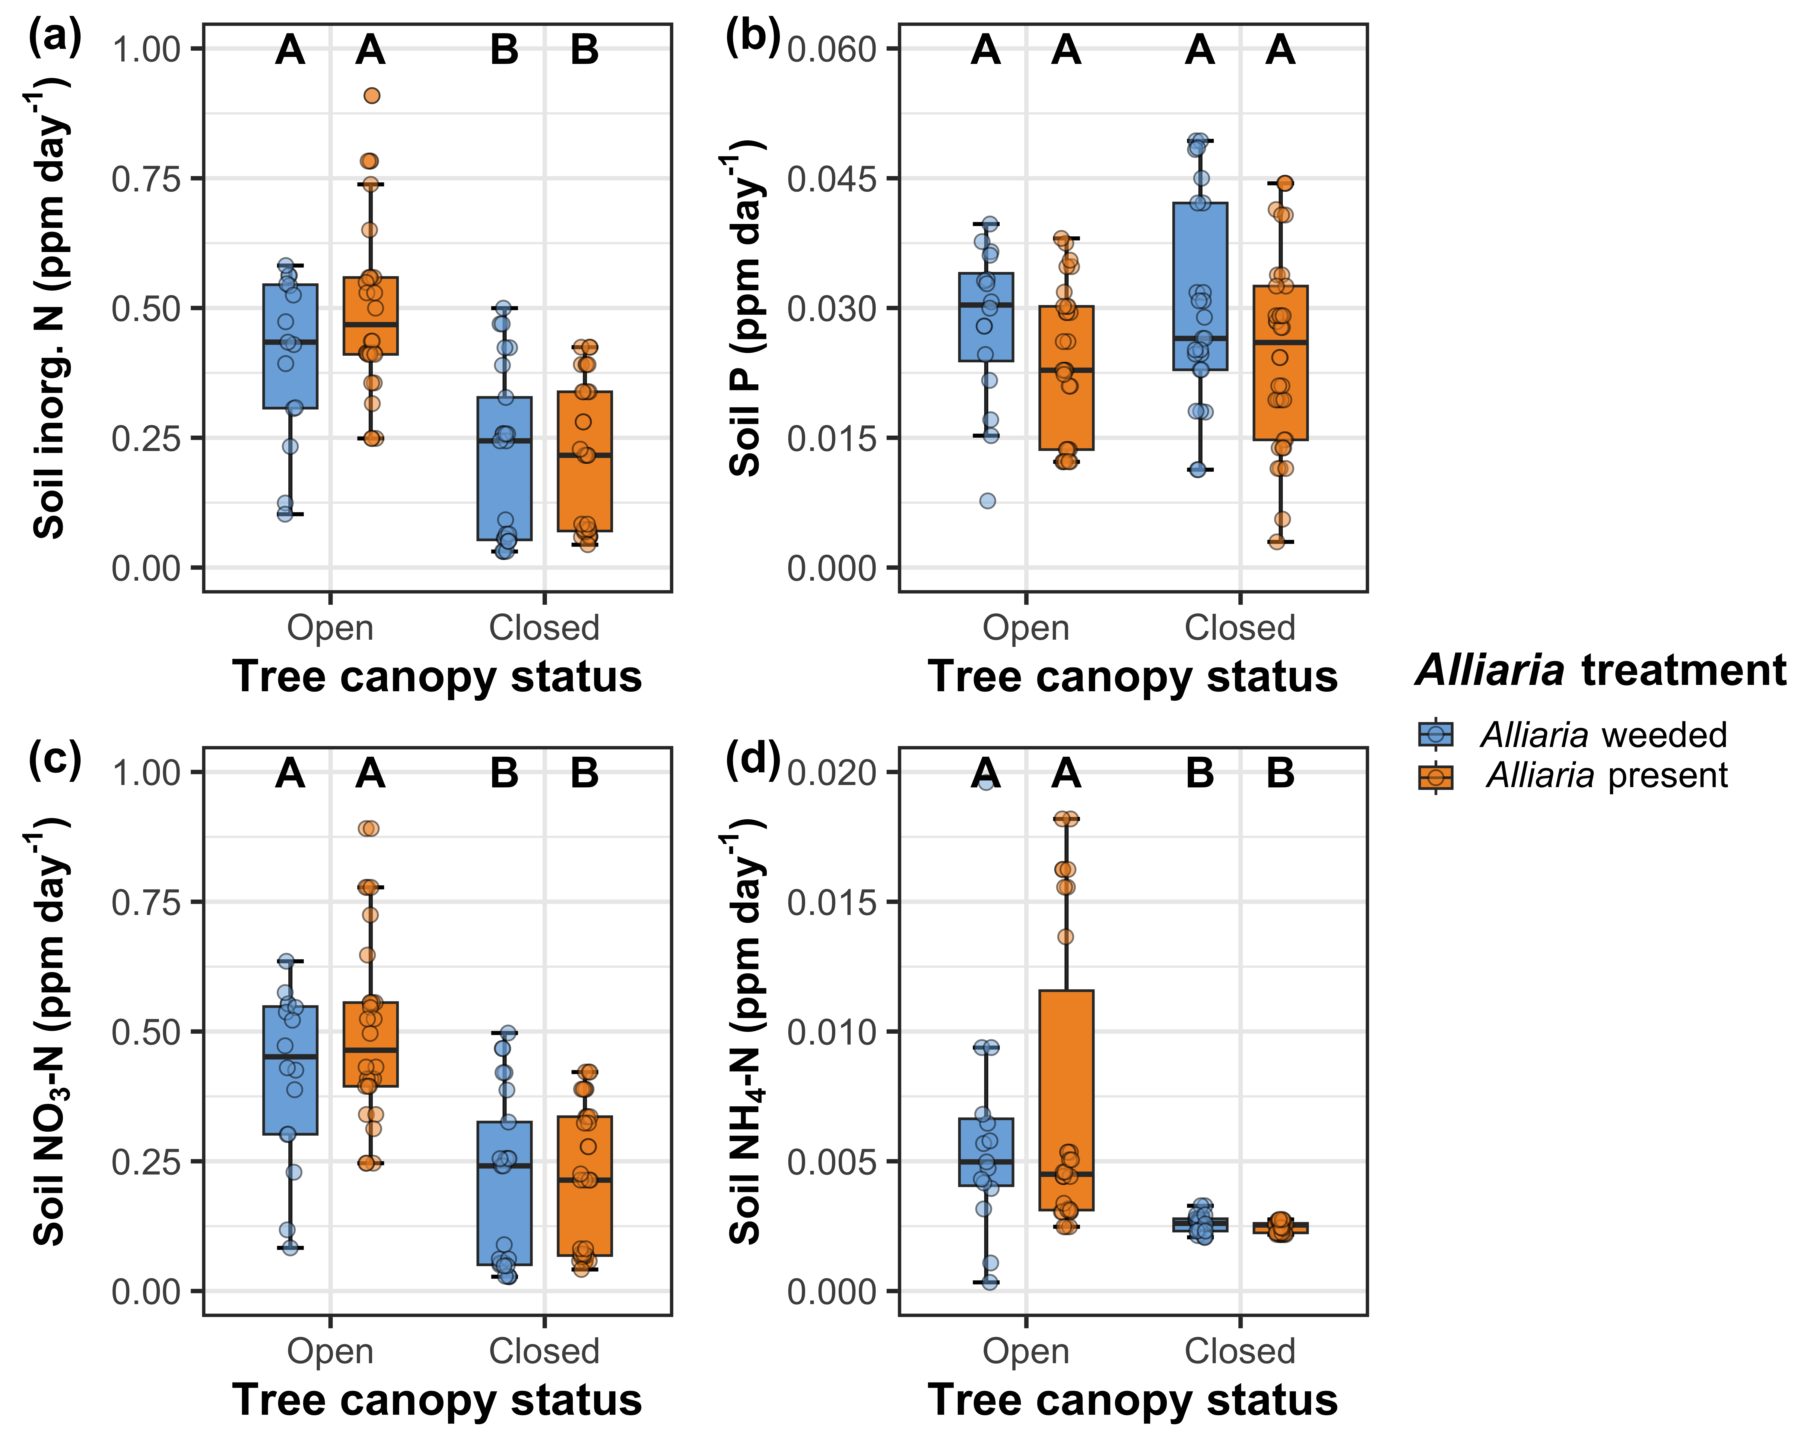
Alliaria presence does not affect soil nutrient availability
Soil nitrogen availability decreases with tree canopy closureAlliaria
Figure 1

Slide 4
Alliaria presence decreases net photosynthesis and stomatal conductance*
Tree canopy closure decreases net photosynthesis
Figure 2

Slide 5
Alliaria presence does not alter indices of photosynthetic capacity*
Tree canopy closure decreases photosynthetic capacity
Figure 3

Slide 6
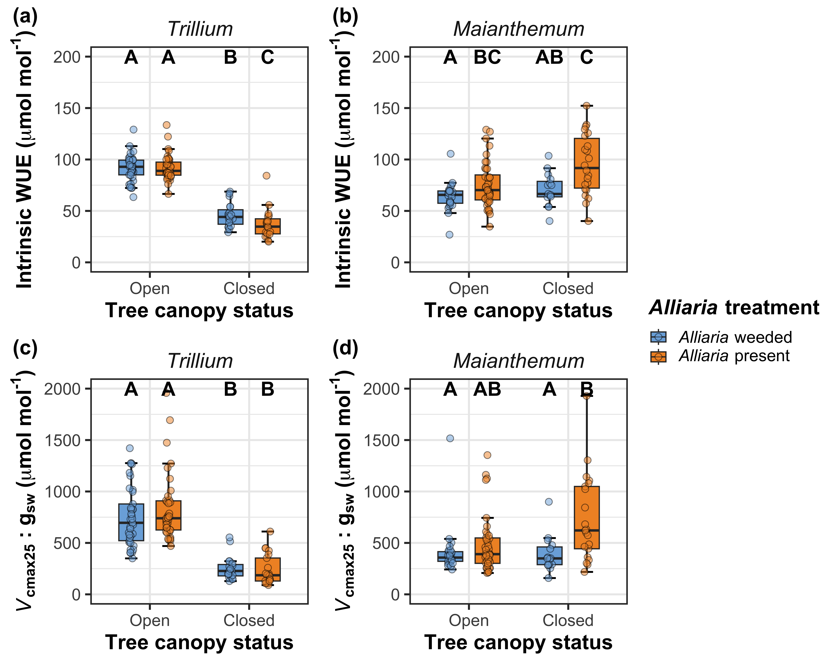
Alliaria presence has species-specific impacts on water-use efficiency and nitrogen-water use tradeoffs*
Tree canopy closure decreases water-use efficiency and nitrogen-water use tradeoffs, but only in Trillium
Figure 4

Slide 7
Key points for Discussion
Alliaria presence only modifies physiology after tree canopy closure
Alliaria presence did not influence A_{net} when tree canopy was open
Alliaria presence decreased A_{net} when tree canopy was established
Alliaria presence decreased closed-canopy A_{net} differently between species
Trillium: associated with decreased J_{max} and iWUE
Maianthemum: associated with reduced g_{sw} and stomatal limitation
Both species exhibit reduced water use in some capacity
Suggests that AM fungal reorganization may alter costs of water uptake?

Slide 8
Some open questions/logistics to figure out
Does it make sense to include some assessment of AM community composition here?
Alternative: sister paper submitted alongside this paper?
Authorship (see next slide)

Slide 9
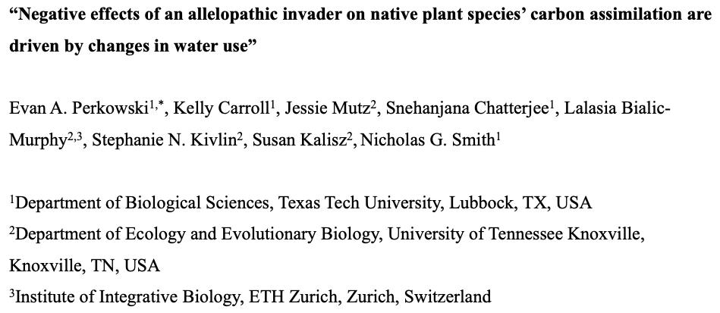
Proposed title and author list
Is there anyone missing here?
Notes:
First few authors ordered based on perceived contributions thus far, followed by alphabetical list of ECR and PI list

